Slide 1







CD & DVD
PRESENTED BY SAMIM & EMON
Name: Md. Samim
ID: 23116
Dept: CSE
Imperial College of Engineering
Name: Md. Emon
ID: 23104
Dept: CSE
Imperial College of Engineering

Slide 2
OVERVIEW
Introduction
History of CD
Technology of CD
History of DVD
Technology of DVD
Comparison

Slide 3
INTRODUCTION
What are CDs and DVDs?
CDs: Compact Discs, primary used for audio storage
DVDs: Digital Versatile Discs, used for video and data storage

Slide 4

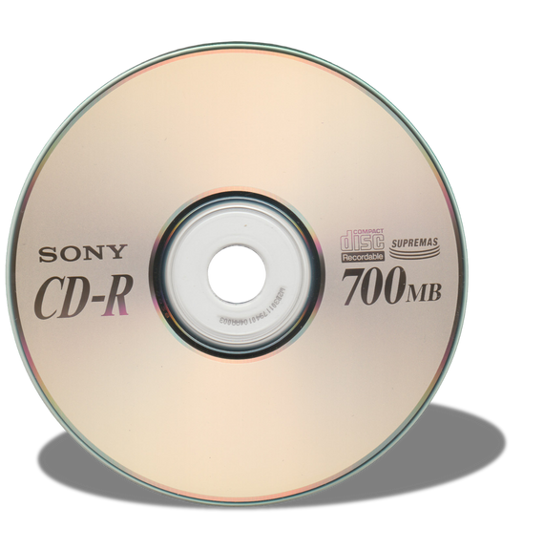

CD
History of CD:
Introduced in the early 1980s by Sony and Philips for digital music.
Became popular in the 1990s but declined with digital downloads and streaming.
CD
CD with player

Slide 5
TECHNOLOGY
Technology Of CD:
Layers: CDs are made of three main layers: a plastic layer, a reflective layer, and a protective layer.
Laser Technology: A laser reads and writes data by detecting pits and flat areas (lands) on the disc.

Slide 6

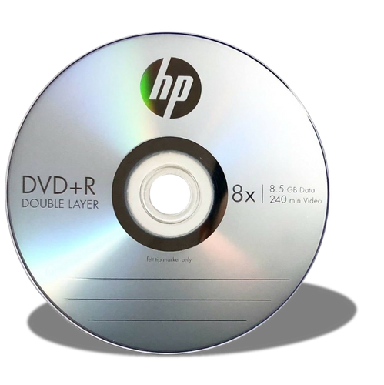
DVD
History of DVD:
Launched in the 1990s for high-quality video storage, replacing VHS tapes.
Gained popularity in the 2000s but has declined with streaming services.
DVD
DVD with player

Slide 7
TECHNOLOGY
Technology Of DVD:
Layers: DVDs have multiple layers for higher data storage than CDs.
Laser Technology: DVDs use a laser to read and write smaller pits and lands for greater data density.

Slide 8
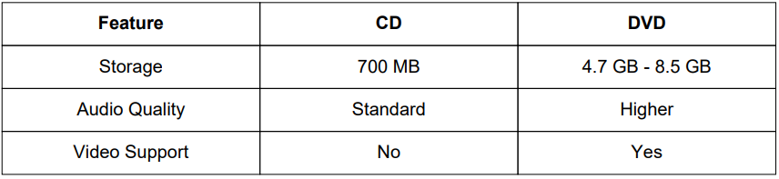
COMPARISON
DVD can store more data due to tighter spacing and more layers.

Slide 9
CONCLUTION
In conclusion, this CD/DVD presentation provides an interactive and easy-to-navigate way to access multimedia content. It’s designed for compatibility with various devices and offers a user-friendly experience. For further assistance, please feel free to contact us. Thank you for viewing!

Slide 10
THANK
YOU

